Slide 1
Networked Federated Multi-Task Learning
Stochastic Block Model Experiment with Two Clusters

Slide 2

Optimization Problem
Generated by a linear model
$y^{(i,r)}={({\overline{w}}^{(i)})}^{T}x^{(i,r)}+σε^{(i,r)}$
$ε^{(i,r)}$: standard Gaussian random variable $𝒩(0,1)$
${\overline{w}}^{(i)}$: piece-wise constant on the partition $𝒫=\left\{C_{1},C_{2}\right\}$

Slide 3
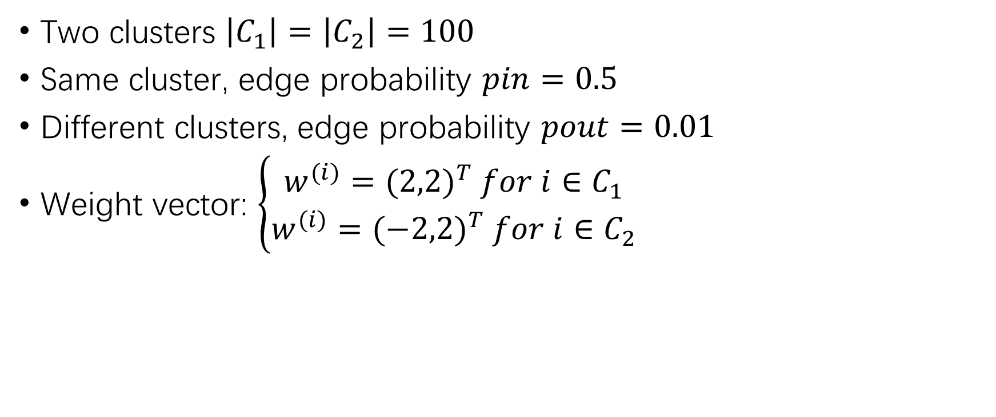
Fundamental Settings
Two clusters $\left|C_{1}\right|=\left|C_{2}\right|=100$
Same cluster, edge probability $pin=0.5$
Different clusters, edge probability $pout=0.01$
Weight vector: $\left\{\begin{aligned}w^{(i)}={(2,2)}^{T} for i∈C_{1} \\ w^{(i)}={(−2,2)}^{T} for i∈C_{2}\end{aligned}\right.$

Slide 4
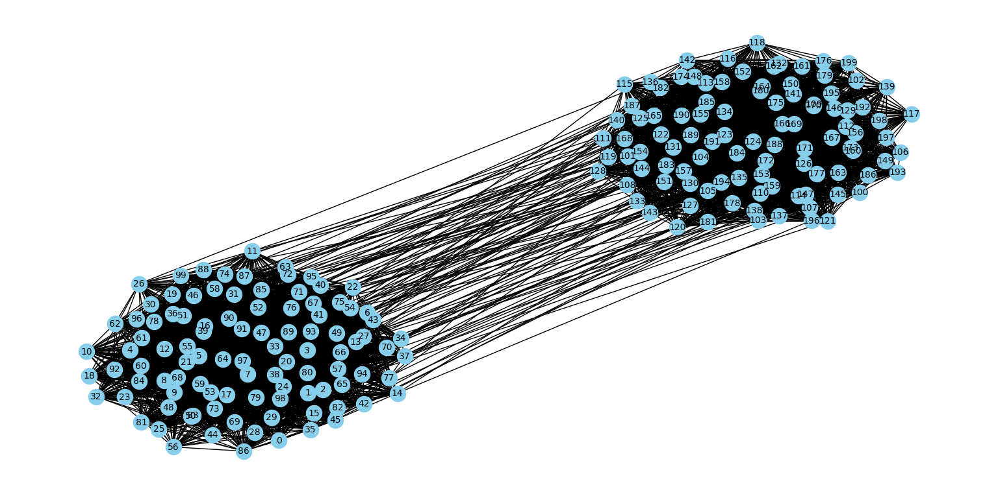
SBM Graph
200 nodes and 5043 edges

Slide 5
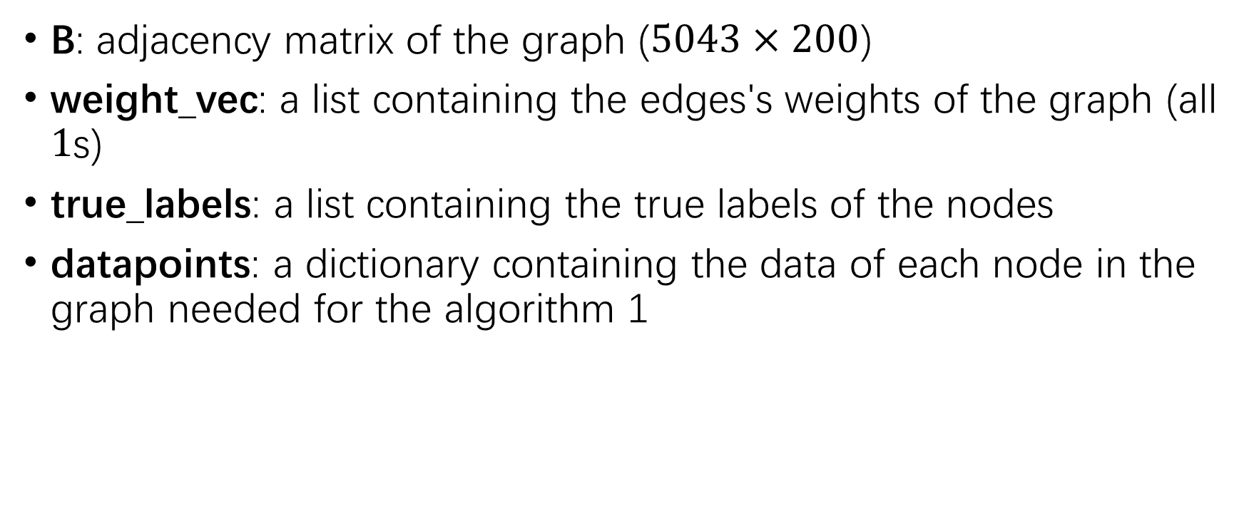
SBM Graph - Returns
B: adjacency matrix of the graph ($5043×200$)
weight_vec: a list containing the edges's weights of the graph (all $1$s)
true_labels: a list containing the true labels of the nodes
datapoints: a dictionary containing the data of each node in the graph needed for the algorithm 1

Slide 6
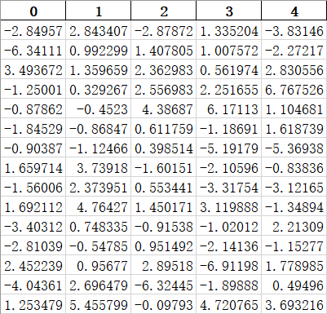
SBM Graph – true_labels
Each node has 5 labels

Slide 7
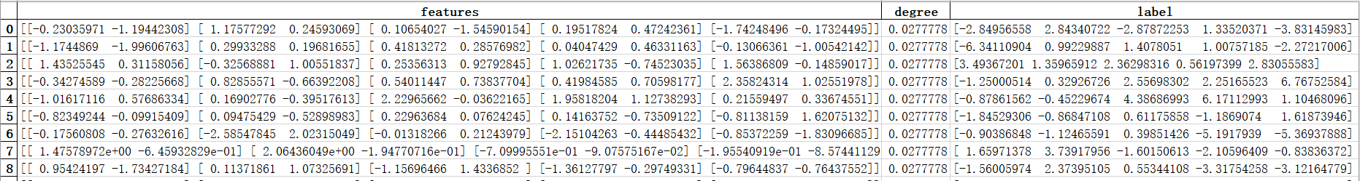
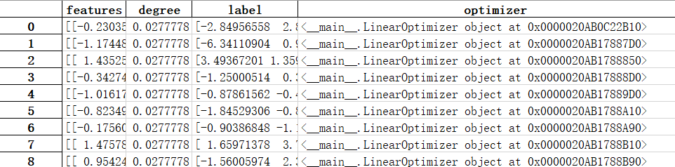
SBM Graph - Datapoints
Each nodes gets information about features, degree, label and optimizer

